Slide 1
Machine learning Mini-project: How does feature scaling affect the efficiency of Gradient Descent?
Yang Wang
Fakultät für Maschinenbau

Slide 2
Agenda
Introduction
Start with a simple model
Detailed analysis
Original vs. Standardized
Original vs. Min-Max scaled
Application

Slide 3
Introduction

Slide 4


Introduction
What is feature scaling?
Min-Max scaling (also called Min-Max normalization, Normalization, Rescaling)
rescales the range of features to [0, 1].
Standardization (also called Z-score normalization)
makes the values of each feature have zero-mean and unit-variance.
can be used not only for normally distributed data but also for others.
x: the original feature vector
μ: the mean of that feature vector
σ: the standard deviation

Slide 5
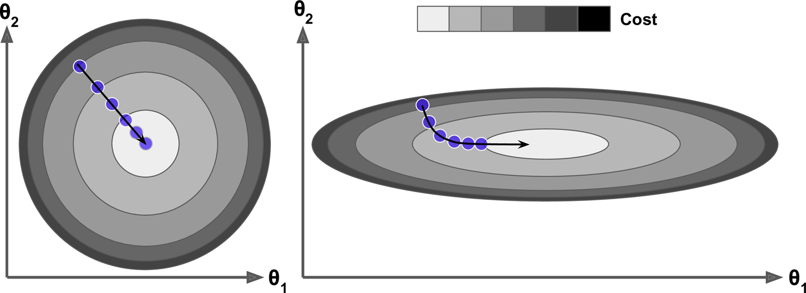
Introduction
The Task: Study the effect of feature scaling on gradient descent.
Some opinions on the internet:
https://www.oreilly.com/library/view/hands-on-machine-learning/9781491962282/ch04.html， 11.28.2020
The cost function has the shape of a bowl. But it can be an elongated bowl if the features have very different scales.
On the left the gradient Descent algorithm goes straight toward the minimum
On the right it first goes in a direction almost orthogonal to the direction of the global minimum, and it ends with a long march along an almost flat valley.

Slide 6
Start with a simple model

Slide 7

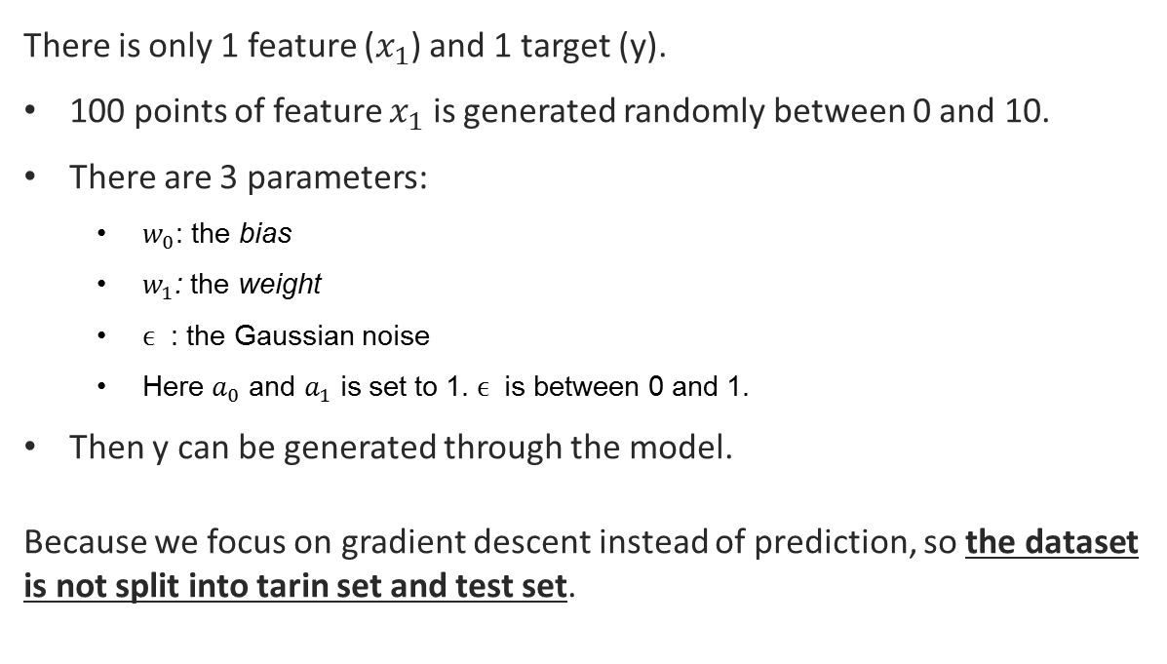
A simple model
A very simple model is used to study the effects of feature scaling on gradient descent.
$$y=w_{0}+{w_{1}x}_{1}+ ϵ$$
There is only 1 feature ($x_{1}$) and 1 target (y).
100 points of feature $x_{1}$ is generated randomly between 0 and 10.
There are 3 parameters:
$w_{0}$: the bias
$w_{1}$: the weight
$ϵ$ : the Gaussian noise
Here $a_{0}$ and $a_{1}$ is set to 1. $ϵ$ is between 0 and 1.
Then y can be generated through the model.
Because we focus on gradient descent instead of prediction, so the dataset is not split into tarin set and test set.

Slide 8
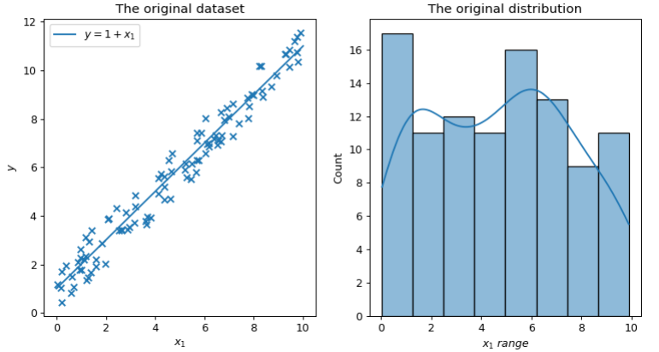
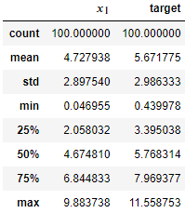
Visualization of original dataset

Slide 9
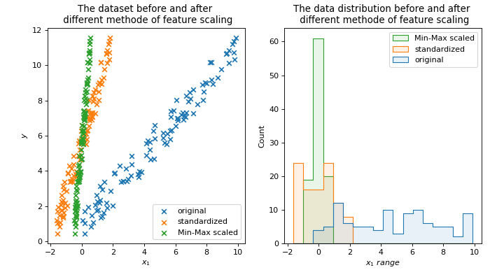
Visualization of feature scaled dataset

Slide 10
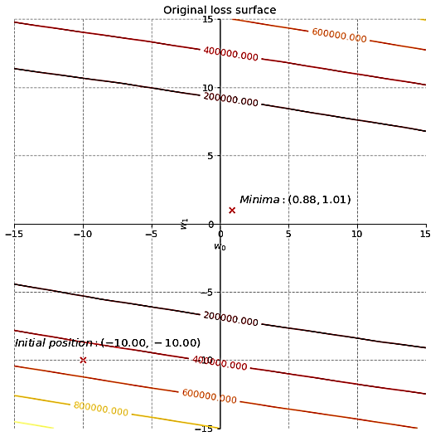
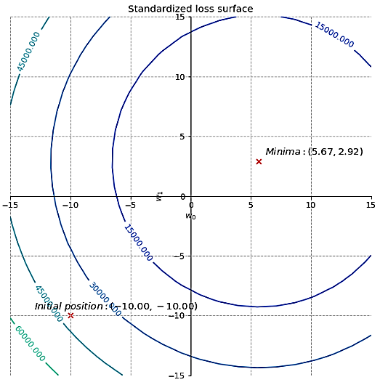
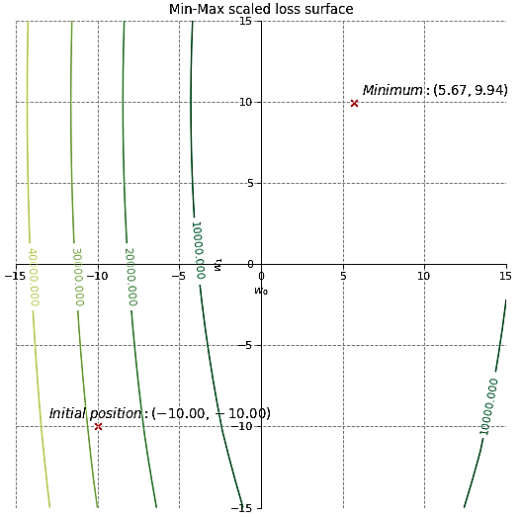
Visualization of loss surface
The original contours look like ellipses, which have a very large major axis.
After standardization, the contours become circles.
After Min-Max scaling, the contours stay ellipses but are more “balanced”.
Note: In addition to the change of function shape, the function is also translated as a whole.

Slide 11
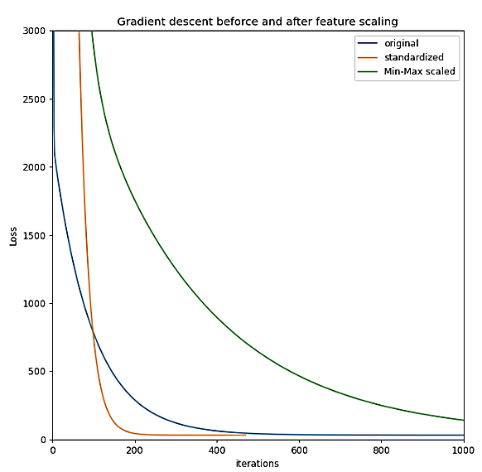
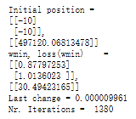
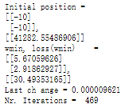
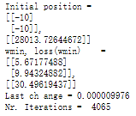
Result of gradient descent
Original
Standardized
Parameters:
Initial position: (-10,-10)
Max iterations = 20000
precision = 0.00001
learning rate = 0.0001
Min-Max scaled
In terms of efficiency, The standardization is better, but Min-Max scaled is worse than the original.
Why?

Slide 12
Detailed analysis:
Original vs. Standardized

Slide 13
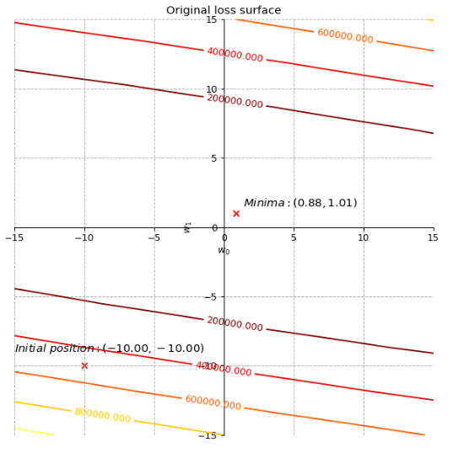
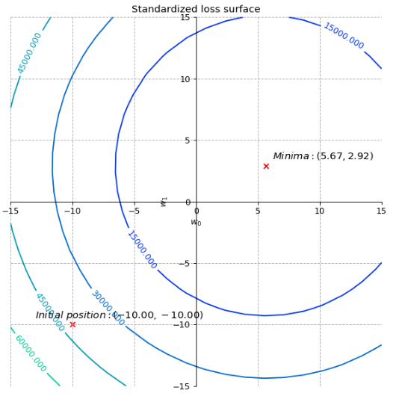
Original vs. Standardized: loss surface

Slide 14
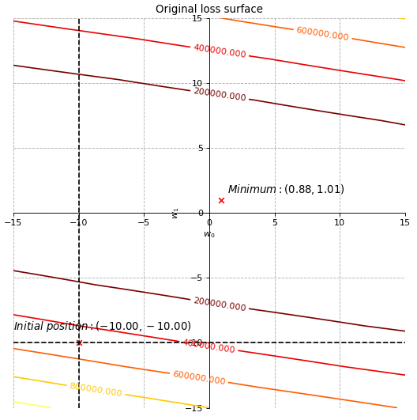
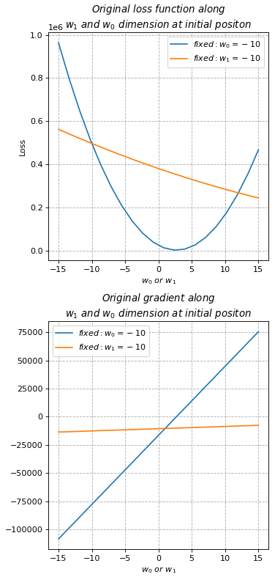
Original vs. Standardized: loss surface

Slide 15
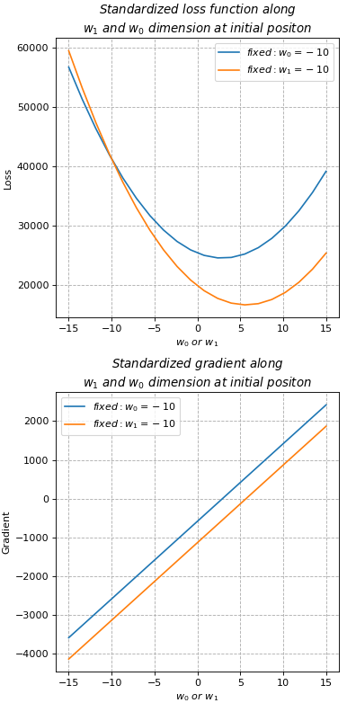
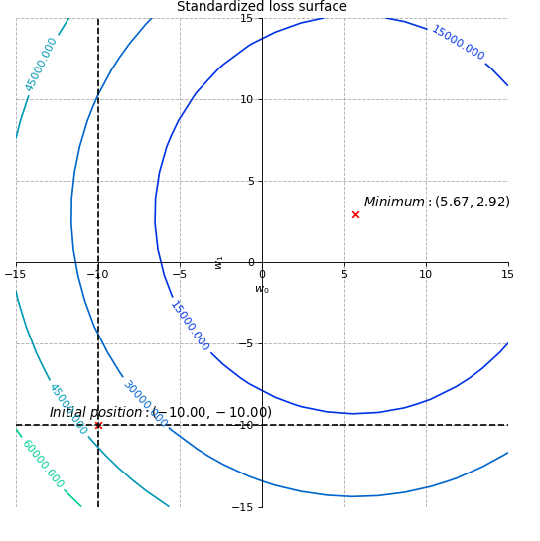
Original vs. Standardized: loss surface

Slide 16
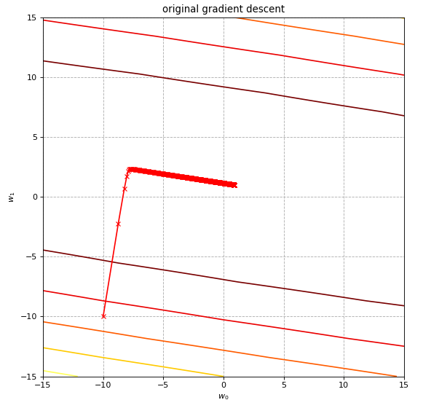
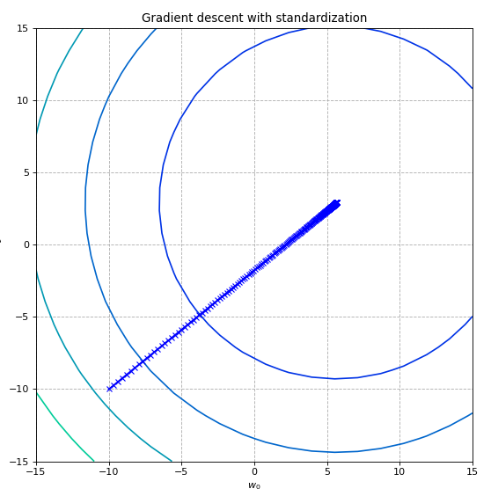
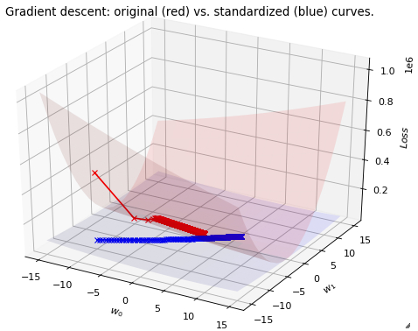
Original vs. Standardized: gradient descent
The standardized gradient descent go straight towards the center of circle. Why?

Slide 17
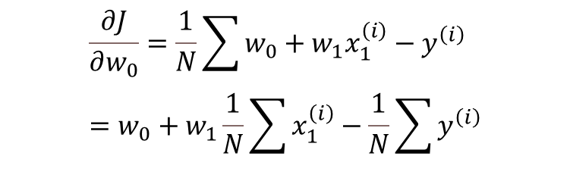
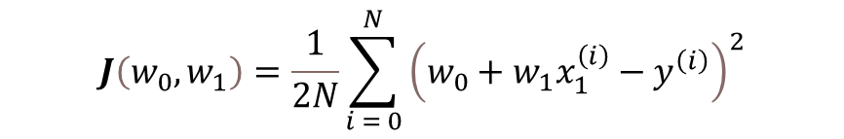
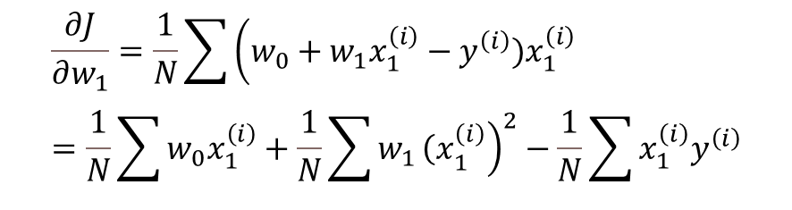
Original vs. Standardized: gradient
Loss function:
$$J\left(w_{0},w_{1}\right)=\frac{1}{2N}\sum_{i = 0}^{N}{{\left(w_{0}+w_{1}x_{1}^{\left(i\right)}−y^{\left(i\right)}\right)}^{2}}$$
$$\frac{∂J}{∂w_{0}}=\frac{1}{N}\sum{w_{0}+w_{1}x_{1}^{\left(i\right)}−y^{\left(i\right)}} =w_{0}+w_{1}\frac{1}{N}\sum{x_{1}^{\left(i\right)}}−\frac{1}{N}\sum{y^{\left(i\right)}}$$
$$\frac{∂J}{∂w_{1}}=\frac{1}{N}\sum{\left(w_{0}+w_{1}x_{1}^{\left(i\right)}−y^{\left(i\right)}\right.})x_{1}^{\left(i\right)}=\frac{1}{N}\sum{w_{0}x_{1}^{\left(i\right)}}+\frac{1}{N}\sum{w_{1}{\left.{\left(x\right.}_{1}^{\left(i\right)}\right)}^{2}}−\frac{1}{N}\sum{x_{1}^{\left(i\right)}y^{\left(i\right)}}$$
The gradient depends on the position of w

Slide 18
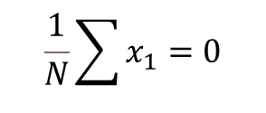
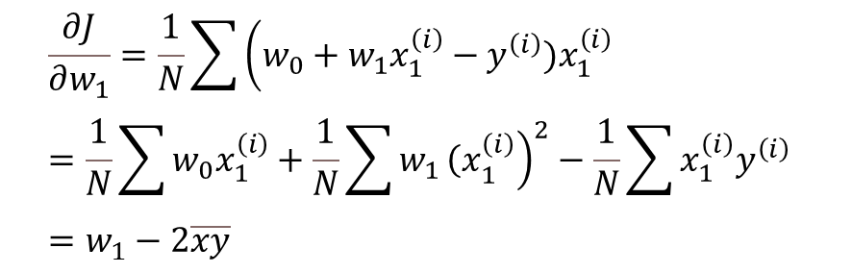

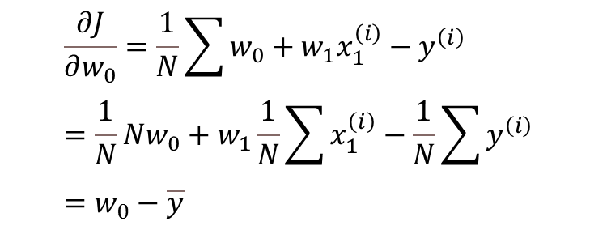
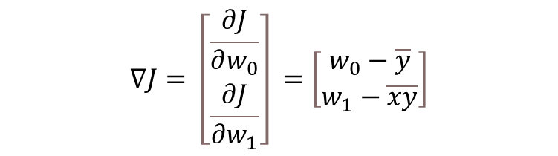
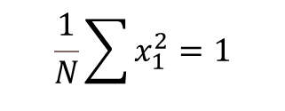
Original vs. Standardized: gradient
$$\frac{1}{N}\sum{x_{1}}=0$$
$$\frac{1}{N}\sum{x_{1}^{2}=1}$$
If $x_{1}$ is standardized value:
$$\frac{∂J}{∂w_{0}}=\frac{1}{N}\sum{w_{0}+w_{1}x_{1}^{\left(i\right)}−y^{\left(i\right)}} =\frac{1}{N}Nw_{0}+w_{1}\frac{1}{N}\sum{x_{1}^{\left(i\right)}}−\frac{1}{N}\sum{y^{\left(i\right)}} =w_{0}−\overline{y}$$
$$\frac{∂J}{∂w_{1}}=\frac{1}{N}\sum{\left(w_{0}+w_{1}x_{1}^{\left(i\right)}−y^{\left(i\right)}\right.})x_{1}^{\left(i\right)}=\frac{1}{N}\sum{w_{0}x_{1}^{\left(i\right)}}+\frac{1}{N}\sum{w_{1}{\left.{\left(x\right.}_{1}^{\left(i\right)}\right)}^{2}}−\frac{1}{N}\sum{x_{1}^{\left(i\right)}y^{\left(i\right)}} =w_{1}−2\overline{xy}$$
$$∇J= \left[\begin{matrix}\frac{∂J}{∂w_{0}} \\ \frac{∂J}{∂w_{1}}\end{matrix}\right] =\left[\begin{matrix}w_{0}−\overline{y} \\ w_{1}−\overline{xy}\end{matrix}\right]$$

Slide 19




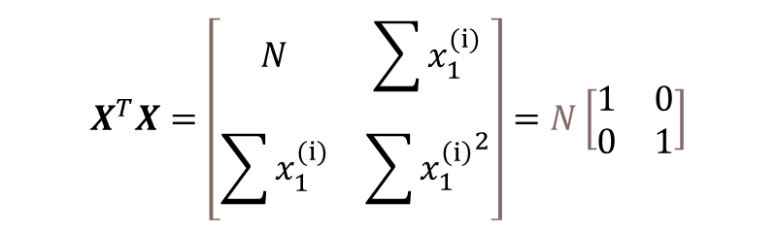


Original vs. Standardized: gradient
$$w^{∗}={\left(X^{T}X\right)}^{−1}X^{T}Y$$
Closed form solution:
$$X= \left[\begin{matrix}1 & x_{1}^{\left(1\right)} \\ … & … \\ 1 & x_{1}^{\left(N\right)}\end{matrix}\right]$$
$$X^{T}X=\left[\begin{matrix}N & \sum{x_{1}^{(i)}} \\ \sum{x_{1}^{(i)}} & \sum{{x_{1}^{\left(i\right)}}^{2}}\end{matrix}\right]=N\left[\begin{matrix}1 & 0 \\ 0 & 1\end{matrix}\right]$$
$$w^{∗}=\left[\begin{matrix}\overline{y} \\ \overline{xy}\end{matrix}\right]$$
$$X^{T}= \left[\begin{matrix}1 & … & 1 \\ x_{1}^{\left(1\right)} & … & x_{1}^{\left(N\right)}\end{matrix}\right]$$
$$X^{T}Y= \left[\begin{matrix}\sum{y} \\ \sum{x_{1}^{(i)} }\end{matrix}\right]$$
$$Y= \left[\begin{matrix}y^{\left(1\right)} \\ … \\ y^{\left(N\right)}\end{matrix}\right]$$

Slide 20
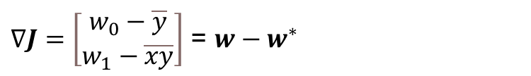


Original vs. Standardized: gradient
$∇J=\left[\begin{matrix}w_{0}−\overline{y} \\ w_{1}−\overline{xy}\end{matrix}\right]$ = $w−w^{∗}$
$w^{∗}$
So, the gradient of the loss function always points to its global minimum position
$$∇J$$
$$w$$

Slide 21
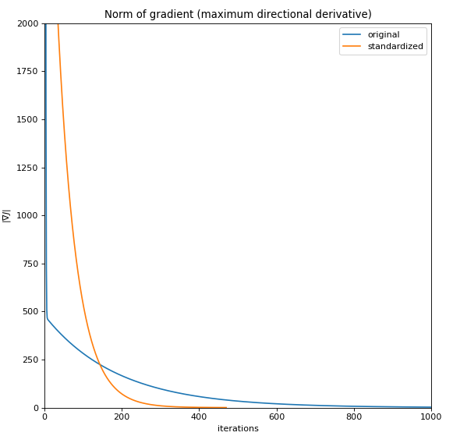
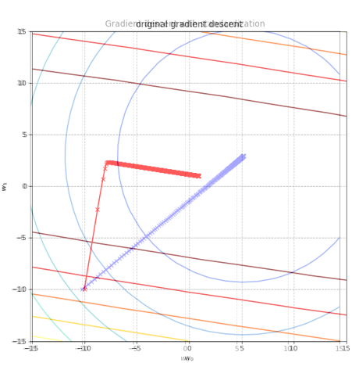

Original vs. Standardized: Norm of gradient
Norm of gradient:
$$\left|∇J\right|= \frac{∂^{2}J}{∂w_{0}^{2}}+ \frac{∂^{2}J}{∂w_{1}^{2}}$$
Gradient indicates the direction in which the function changes the fattest.
L2-Norm of gradient indicates the changing rate or “velocity” in this direction which equals the maximum directional derivative.
We can see that the “average velocity” of standardized gradient descent is much larger

Slide 22
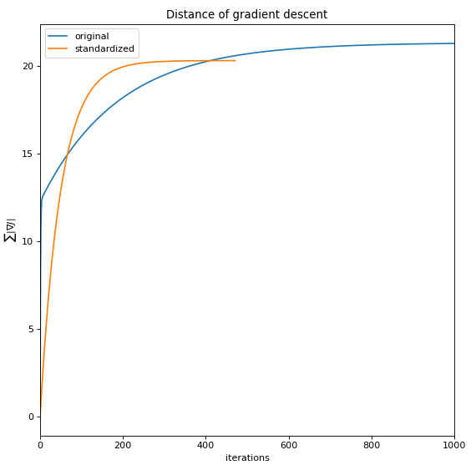

Original vs. Standardized: Distance of gradient descent
Let’s Integrate the norm to see the distance traveled by gradient descent
$$L=\int{\left|∇J\right|}= \sum{\left|∇J_{i}\right|}$$
We can see that the standardized gradient descent still travels a shorter distance than the original, although its solution position is further.

Slide 23
Detailed analysis:
Original vs. Min-Max scaled

Slide 24
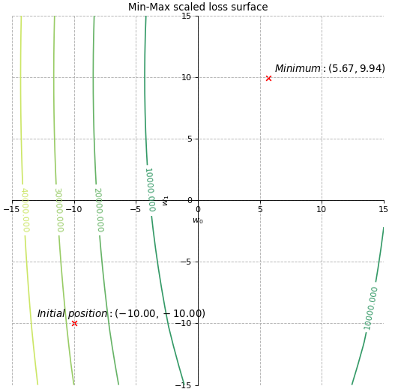
Original vs. Min-Max scaled: Loss surface

Slide 25
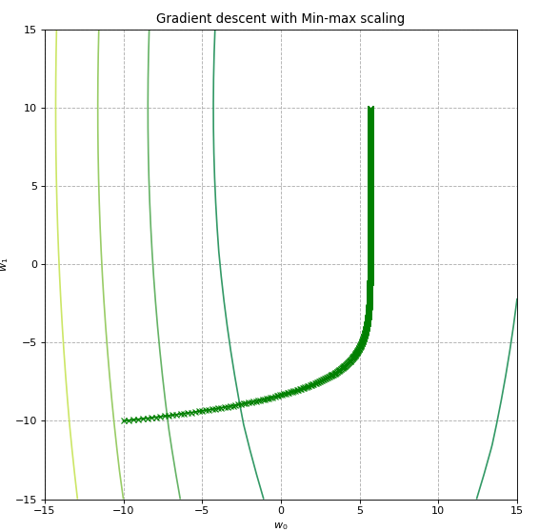
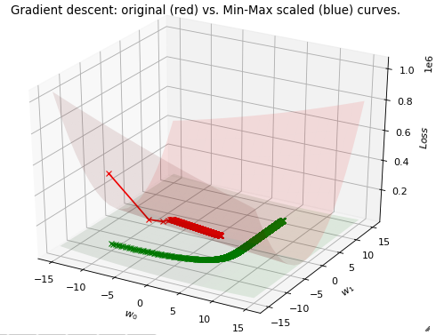
Original vs. Min-Max scaled: Loss surface
The traces of both gradient descent seem similar.
But the steps of Min-Max scaled one is much tighter

Slide 26
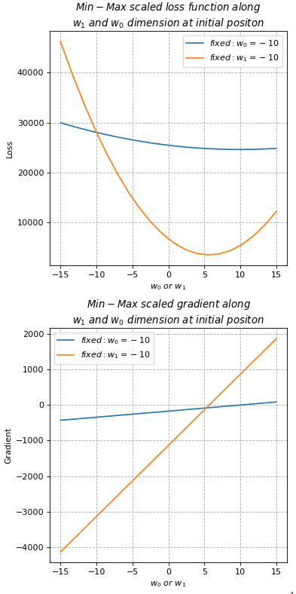
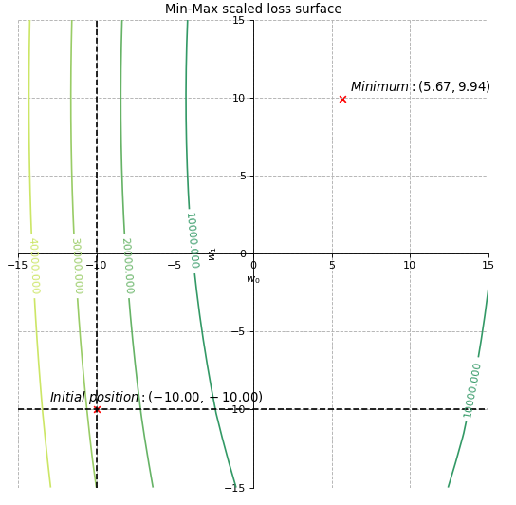
Original vs. Min-Max scaled: loss function & gradient along one axis

Slide 27
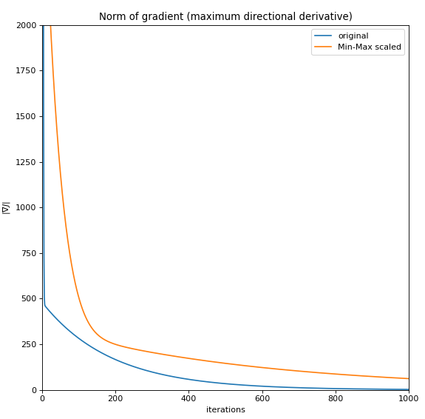
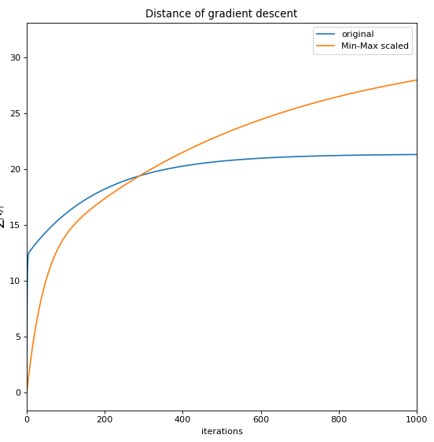
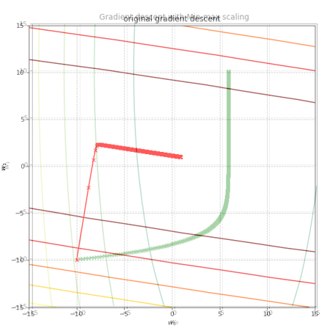
Original vs. Min-Max scaled: Norm of gradient
The Min-Max scaled gradient descent travels faster. But unfortunately, its goal is further.
Choosing another initial position may lead to a better result …

Slide 28
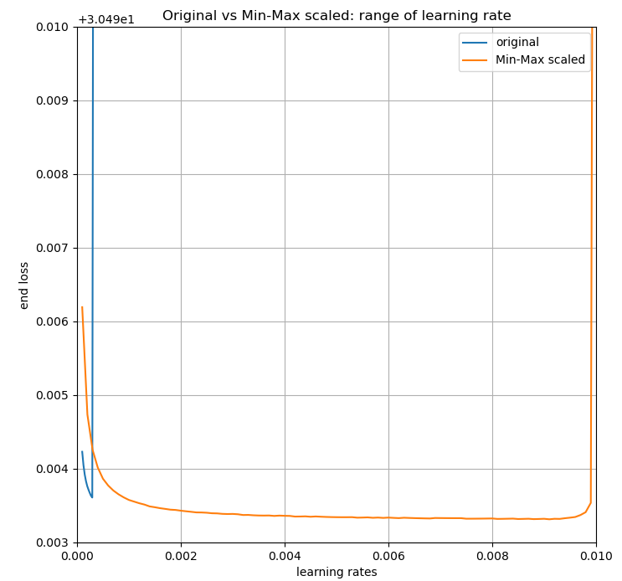
Original vs. Min-Max scaled: Learning rate
In the other hand, compared with the original data, Min-Max scaling provides a possibility to choose a greater learning rate.

Slide 29
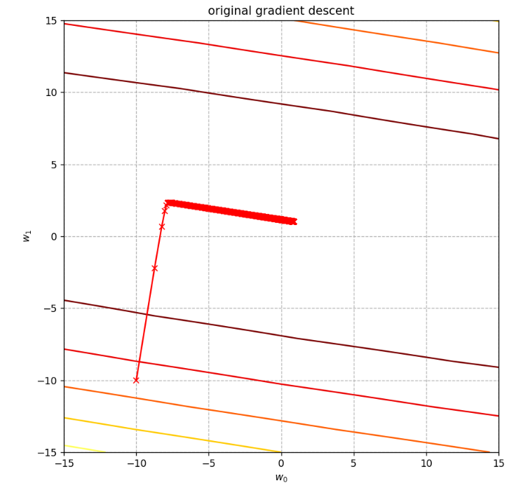
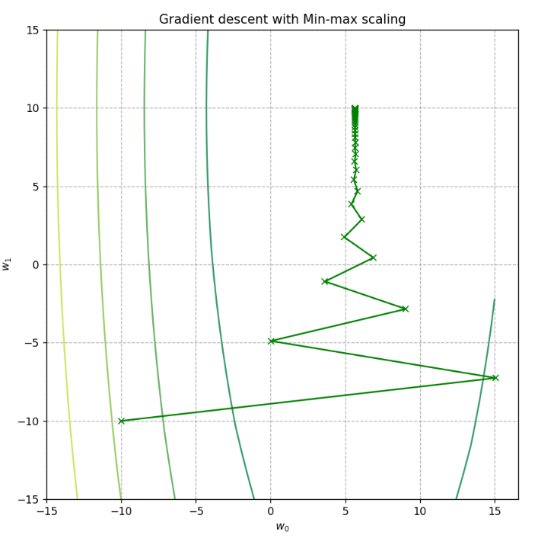
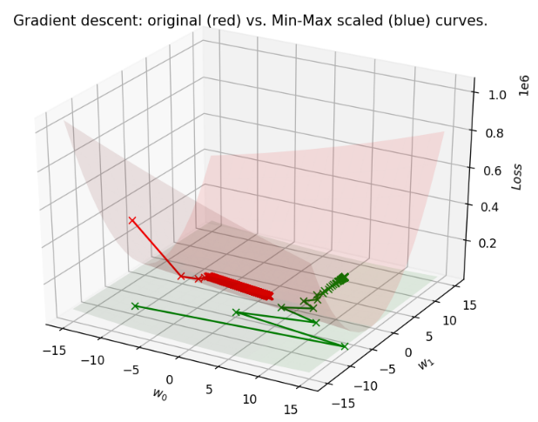
Original vs. Min-Max scaled: Learning rate
Learning rate = 0.0001
Nr. Iterations = 1380
Learning rate = 0.008
Nr. Iterations = 62

Slide 30
Conclusion
Standardization or Min-Max scaling?
If we only focus on gradient descent, standardization is better than Min-Max scaling.
However, this doesn’t mean that Min-Max scaling is not useful at all!
If we focus on other points, these two kind of feature scaling methods both have their own applicable situations. For example: when some models need to calculate L2 distance (such as KNN), Min-Max scaling is much more useful.

Slide 31
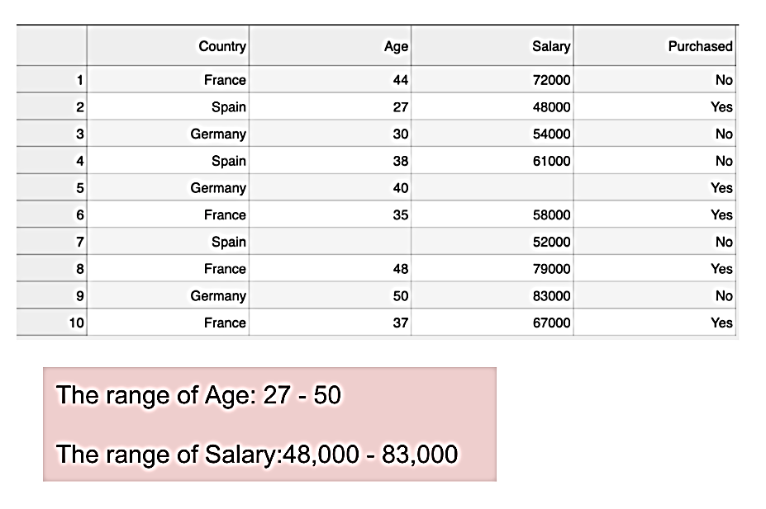
Example
This is a dataset that contains an independent variable (Purchased) and 3 dependent variables (Country, Age, and Salary).
The range of Salary (48,000 – 83,000) is much wider than the range of Age (27 - 50).
https://www.kdnuggets.com/2020/04/data-transformation-standardization-normalization.html

Slide 32
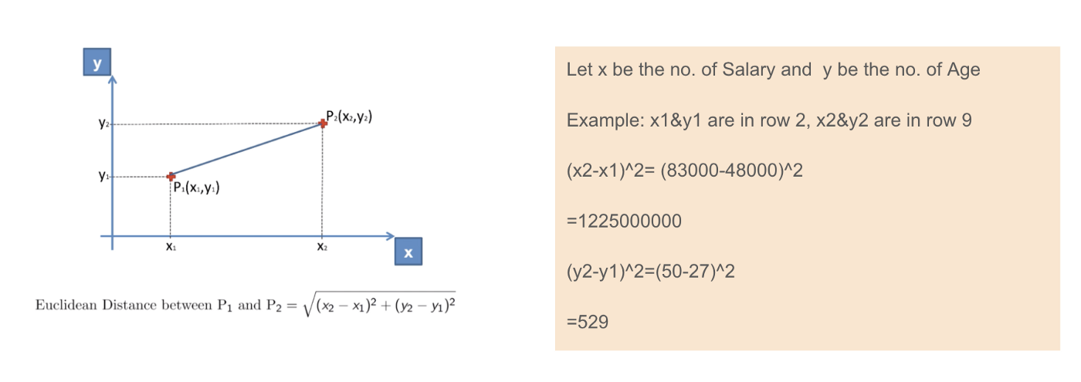
https://www.kdnuggets.com/2020/04/data-transformation-standardization-normalization.html
When we calculate the equation of Euclidean distance, the number of (x2-x1)² is much bigger than the number of (y2-y1)² which means the Euclidean distance will be dominated by the salary。
Therefore, in this case, we'd better Min-Max scale the dataset, so that different features have the same influence on the distance.

Slide 33
Application

Slide 34
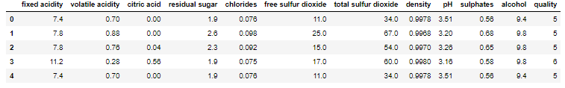


Dataset
Red wine dataset

Slide 35

Procedure
Split the dataset into X_train, X_test, y_train, y_test
2. Use class StandardScaler standardize X_train and X_test.
Note:
It is unnecessary to standardize y.
Use the mean value and standard deviation of X_train to standardize X_test!
3. Use class LinearRegression train and predict.
4. Evaluate the model by e.g. R-square.

Slide 36

Evaluation on training set
Feature scaling have no effect on the result of prediction.

Slide 37

Efficiency of training
With feature scaling, the training time is reduced significantly.
Training of standardized and min-Max scaled dataset have almost the same efficiency

Slide 38
References
https://www.kdnuggets.com/2020/04/data-transformation-standardization-normalization.html
Wan X. Influence of feature scaling on convergence of gradient iterative algorithm[C]//Journal of Physics: Conference Series. IOP Publishing, 2019, 1213(3): 032021.
https://towardsdatascience.com/gradient-descent-the-learning-rate-and-the-importance-of-feature-scaling-6c0b416596e1
https://sebastianraschka.com/Articles/2014_about_feature_scaling.html#about-min-max-scaling

